Slide 1
Design, Implementation and Management of Database Systems
Relational Algebra
Dr. Xiao Yan
School of Computer Science
yanxiaosunny@whu.edu.cn

Slide 2
Introduction
Query languages are specialized languages for asking questions or queries, that involve the data in a database.
Queries in algebra are composed of a collection of operators.
Every operator in relational algebra accepts (one or two) relation instances as arguments and returns a relation instance as the result.
  A relational algebra expression is recursively defined to be a relation.
  Relational algebra is a procedural query language
    Define a step-by-step procedure for computing the desired answer.

Slide 3
Basic Operators
There are six basic operators in relation algebra:
  select ( σ )
  project ( Π )
  union ( U )
  set different ( - )
  Cartesian product ( x )
  rename ( ρ )

Slide 4
Selection
  The selection operation σ specifies the tuples to retain through a selection condition.
  Selection condition is a Boolean combination (an expression using logical connectives ∧ and ∨) of terms that have the form
    attribute op constant
    attribute1 op attribute2
    (op is one of the comparison operators <, ≤, =, ≠, >, ≥).
    ∧ means logical and, while ∨ is logical or

Slide 5

Relation R
σ _{a=b d>5} ( R )
a
b
c
d
α
α
1
7
a
b
c
d
α
β
5
7
α
α
1
7
β
β
12
3
β
β
23
10
β
β
23
10

Slide 6
Projection
  The projection operator Π allows us to extract columns from a relation.
  The subscript specifies the fields to be retained.
  (The other fields are ‘projected out’).
  The schema of the result of a projection is determined by the fields that are projected.
  Duplicated row will be eliminated in the final result.
    This follows from the definition of a relation as a set of tuples.

Slide 7
Relation R
Π _{a,c} ( R )
a
b
c
a
c
a
c
α
10
1
α
1
α
1
α
20
1
α
1
Eliminate
Duplicated
rows
β
1
β
30
1
β
1
β
2
β
40
2
β
2

Slide 8
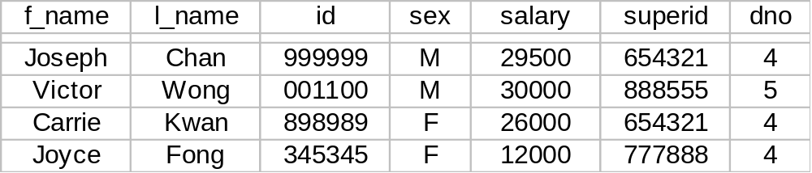
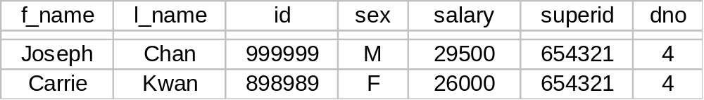
Employee
Find all employees who works in department 4 and whose
salary is greater than 25000.
σ _{dno=4 salary>25000} (Employee)

Slide 9
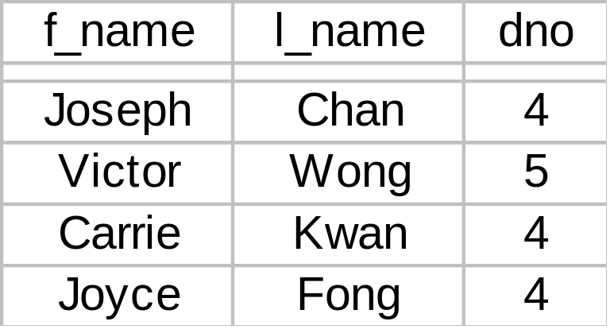
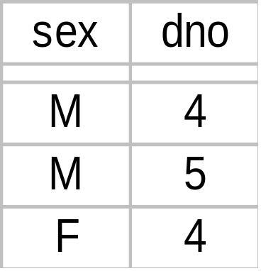
Find the employee names and department number of all
employees
Find the sex and department number of all employees
Π _{f_name,l_name,dno} ( Employee )
Π _{sex,dno} ( Employee )

Slide 10
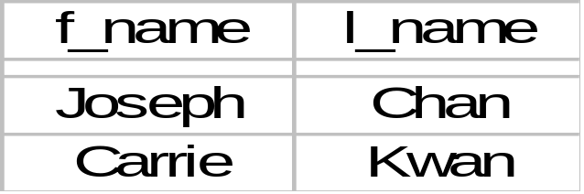
  Compositing operation gives relational-algebra expression.
  The result of a relational-algebra expression is always a relation.
Find the first name and last name for all employees who works in department 4 and whose salary is greater than 25000.
Π _{f_name,l_name} ( σ _{dno=4^salary>25000} ( Employee ) )

Slide 11
Union
  R ∪ S returns a relation instance containing all tuples that occur in either relation R or relation instance S (or both).
  The union operation is commutative: R ∪ S = S ∪ R
  Duplicate tuples are eliminated.
  R and S must be union-compatible.
    They have the same number of fields,
    The corresponding fields have the same domains.
      The field names are not important
  The schema of the result is defined to be identical to the schema of R.
    The field of R ∪ S inherit names from R.

Slide 12
a
b
a
b
a
b
α
1
α
1
R
S
α
2
R U S
α
2
α
2
β
3
β
1
β
1
β
3

Slide 13
Set Difference
  Set difference R – S returns a relation instance containing all the tuples that occur in R but not in S.
  The set difference is not commutative: in general, R – S ≠ S – R.
  The relations R and S must be union-compatible.
  The schema of the result is defined to be identical to the schema of R.

Slide 14
a
b
a
b
a
b
α
1
R
S
α
2
R - S
α
1
α
2
β
3
β
1
β
1

Slide 15

Intersection
  R ∩ S returns a relation instance containing all tuples that occur in both R and S.
  The relations R and S must be union-compatible.
  The schema of the result is defined to be identical to the schema of R.
  Intersection is not considered a basic operation, as it can be derived from the basic operations as shown below:

Slide 16
a
b
a
b
a
b
α
1
R
S
α
2
R ∩ S
α
2
α
2
β
3
β
1

Slide 17
Rename (ρ)
  ρ ( R(F), E ) or ρ ( R, E )
    where E is an arbitrary relation algebra expression
  result: relation named R,
  R = E except that the fields may be renamed according to F.
  F is called the renaming list:
  oldname → newname or position → newname.

Slide 18
Example
ρ ( C ( sid → identity ), E )
We may rename more fields:
ρ ( C ( sid → identity, child → dependent ), E )
Example
ρ ( C ( 3 → identity ), E )
Result is C
3rd attribute in E is renamed as “identity” in C

Slide 19
Cartesian product (Cross product)
  R × S returns a relation instance whose schema contains all the fields of R followed by all the fields of S.
  The result contains one tuple <r,s> (concatenation of tuples r and s) for each pair of tuples r ∈ R, s ∈ S.

Slide 20
R × S
a
b
c
d
e
S
α
1
α
10
+
R
c
d
e
α
1
β
10
+
a
b
α
10
+
α
1
β
20
-
α
1
β
10
+
α
1
γ
10
-
β
2
β
20
-
β
2
α
10
+
γ
10
-
β
2
β
10
+
β
2
β
20
-
β
2
γ
10
-

Slide 21
Query: To retrieve for each female employee a list of the names of her dependents.
EMPLOYEE
f_name
l_name
id
bdate
addr
sex
salary
super_id
dno
DEPENDENT
eid
dependent-name
sex
bdate
relationship

Slide 22
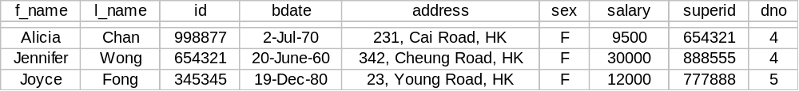
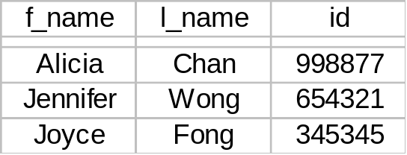
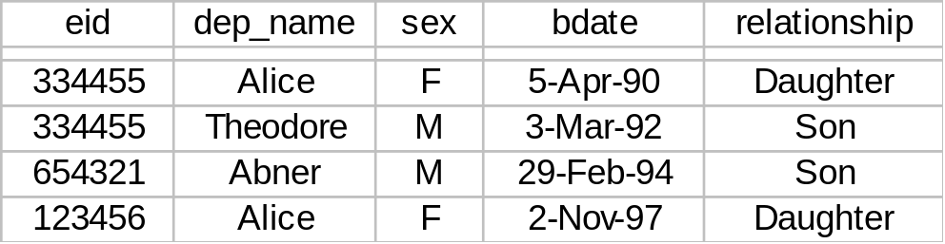
Female_emps ← σ _{sex=‘F’} ( Employee )
Empnames ← Π _{f_name,l_name,id} ( Female_emps )
Female_emps
Empnames
Dependents

Slide 23
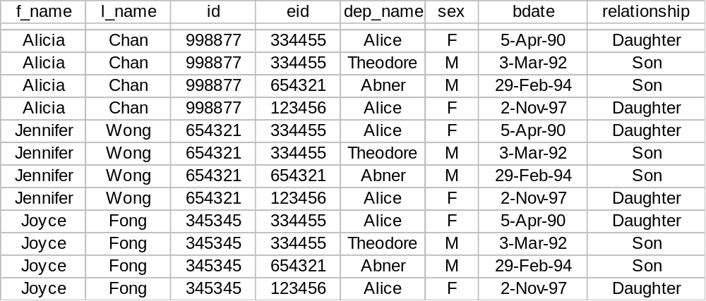
Emp_departments ← Empnames x Departments
Emp_dpartments

Slide 24
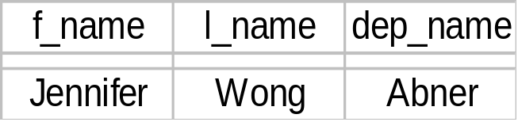
Query: To retrieve for each female employee a list of the names of her dependents
Actual_departments ← σ _{id=eid} ( Emps_departments )
Result ← Π _{f_name,l_name,dep_name} ( Actual_departments )
Actual_departments
Result

Slide 25
Join
  Because the sequence of operations, × followed by σ is quite common, a special operations, called the “join” operation ( ) was created to specify these as a single operation.
  Join can be defined as a cross-product followed by selections and sometimes with projections.
  The result of a cross-product is typically much larger than the result of a join, and it is very important to recognize joins and implement them without materializing the underlying cross-product.

Slide 26
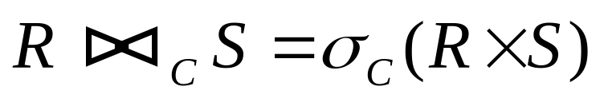
Condition Join
  The most general version of join operation accepts a join condition c.
  The join condition is identical to a selection condition in form.
  The operation is defined as follows:

Slide 27
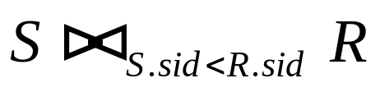
S
R
sid | sname | rating | age
22 | Dustin | 7 | 45.0
31 | Lubber | 8 | 55.5
58 | Rusty | 10 | 35.5
sid | bid | day
22 | 101 | 10/10/96
58 | 103 | 11/12/96
(sid) | sname | rating | age | (sid) | bid | day
22 | Dustin | 7 | 45.0 | 58 | 103 | 11/12/96
31 | Lubber | 8 | 55.5 | 58 | 103 | 11/12/96

Slide 28
S
R
sid | sname | rating | age
22 | Dustin | 7 | 45.0
31 | Lubber | 8 | 55.5
58 | Rusty | 10 | 35.5
sid | bid | day
22 | 101 | 10/10/96
58 | 103 | 11/12/96
(sid) | sname | rating | age | (sid) | bid | day
22 | Dustin | 7 | 45.0 | 58 | 103 | 11/12/96
31 | Lubber | 8 | 55.5 | 58 | 103 | 11/12/96

Slide 29
Example
Query: Find the names of employees with the highest salary.
Π _{l_name,f_name} ( Employee ) -
Π Employee.l_name, Employee.f_name (
Employee _{Employee.salary<F.salary} ρ ( F, Employee ) )
Note: We assume that <l_name,f_name> is a key in this relation.

Slide 30
Equi-join
  A special case of the join operation is when the join condition consists solely of equalities (connected by ∧) of the form
  R.name1 = S.name2
  In the resulting relation, S.name2 will be dropped by an additional projection operation.

Slide 31

R
S
a
b
c
b
e
f
a
b
c
e
f
α
1
α
1
X
α
α
1
α
X
α
β
5
γ
3
X
β
α
1
α
X
γ
γ
4
β
1
X
γ
α
1
γ
X
α
α
1
γ
2
Y
δ
α
1
γ
X
γ
δ
2
β
3
Y
ε
δ
2
β
Y
δ

Slide 32
R
S
a
b
c
b
e
f
a
b
c
e
f
α
1
α
1
X
α
α
1
α
X
α
β
5
γ
3
X
β
α
1
α
X
γ
γ
4
β
1
X
γ
α
1
γ
X
α
α
1
γ
2
Y
δ
α
1
γ
X
γ
δ
2
β
3
Y
ε
δ
2
β
Y
δ

Slide 33

Natural Join
  A further special case of the join operation is an equijoin in which equalities are specified on all fields having the same names in R and S.
  We can simply omit the join condition.
  The resulting schema contains the attributes of R followed by the attributes in S that are not in R.
  If the two relations have no attributes in common, is simply the cross-product.

Slide 34
R
S
a
b
c
d
b
d
e
R S
α
1
α
X
1
X
α
a
b
c
d
e
β
2
γ
X
3
X
β
α
1
α
X
α
γ
4
β
Y
1
X
γ
α
1
α
X
γ
α
1
γ
Y
2
Y
δ
δ
2
β
Y
δ
δ
2
β
Y
3
Y
ε

Slide 35
R
S
a
b
c
d
b
d
e
R S
α
1
α
X
1
X
α
a
b
c
d
e
β
2
γ
X
3
X
β
α
1
α
X
α
γ
4
β
Y
1
X
γ
α
1
α
X
γ
α
1
γ
Y
2
Y
δ
δ
2
β
Y
δ
δ
2
β
Y
3
Y
ε

Slide 36
Division
  The division operation is useful for expressing certain kinds of queries, for example, “find the names of sailors who have reserved all boats.
  Example
    Consider two relations A and B.
    A has exactly two fields x and y.
    B has just one field y, with the same domain as in A.
    The division operation A/B is the set of all x values (in the form of unary tuples) such that for every y value in a tuple of B, there is a tuple <x,y> in A.

Slide 37
x
y
y
x
α
1
B
1
A / B
α
α
2
2
ε
α
3
β
1
A
γ
1
The division operation A/B is the set of all x values (in the form of unary tuples) such that for every y value in a tuple of B, there is a tuple <x,y> in A.
δ
1
δ
3
δ
4
ε
1
ε
2

Slide 38
x
y
y
x
α
1
B
1
A / B
α
α
2
2
ε
α
3
β
1
A
γ
1
Another way to understand division is as follows:
For each x value in A, consider the set of y
values that appear in tuples of A with that
x value. If this set contains all y values in
B, the x value is in the result of A/B.
δ
1
δ
3
δ
4
ε
1
ε
2

Slide 39




x
y
y
x
α
1
B
1
A / B
α
α
2
2
ε
α
3
β
1
An analogy with integer division may also help
to understand division. For integers A and B,
A/B is the largest integer Q such that . for relation instances A and B, A/B is the largest relation instance Q such that
A
γ
1
δ
1
δ
3
δ
4
In fact we can compute the disqualified tuples
using the following algebra expression:
Thus, A/B is
ε
1
ε
2

Slide 40
The division above can be written in terms of basic operations:
Temp1 ← Π _{A-B} ( A )
Temp2 ← Π _{A-B} ( ( Temp1 × B ) – A )
Result = Temp1 – Temp2
A
B
Attributes in A but
not in B. Note that it is not a
valid notation in relational algebra.
x
y
y
α
1
1
α
2
2
α
3
β
1
( Temp1 × B ) – A
x
Temp1
x
x
y
γ
1
A / B
α
α
δ
1
β
2
ε
β
δ
3
γ
2
γ
δ
4
δ
2
δ
ε
1
ε
ε
2
Temp2

Slide 41

Employee
fname
lname
id
bdate
address
salary
sid
dno
Works_on
id
pno
Query: Retrieve the names of employees who work on all the projects that `John Sung’ works on.
Sung ← σ _{fname=“John” ^ lname=“Sung”} ( Employee )
Sung_pnos ← Π _{pno} ( Works_on Sung )
fname
lname
id
bdate
address
salary
sid
dno
pno
Result_id ← Works_on / Sung_pnos
Result ← Π _{fname,lname} ( Result_id Employee )

Slide 42
4.8 More examples
Sailors ( sid, sname, age )
Boats ( bid, bname, color )
Reserves ( sid, bid, date )
Consider the above schemas, the primary key fields are
underlined.

Slide 43
Sailors ( sid, sname, age )
Boats ( bid, bname, color )
Reserves ( sid, bid, date )
Query 1: Find the names of sailors who have reserved boat with bid = 103.
Solution 1:
Π _{sname} ( ( σ _{bid=103} Reserves ) Sailors )
More
efficient
Solution 2:
ρ ( Temp1, σ _{bid=103} Reserves )
ρ ( Temp2, Temp1 Sailors )
Π _{sname} ( Temp2 )
Solution 3:
Π _{sname} ( σ _{bid=103} ( Reserves Sailors ) )

Slide 44
Sailors ( sid, sname, age )
Boats ( bid, bname, color )
Reserves ( sid, bid, date )
Query 2: Find the names of sailors who have reserved at
least a red boat.
Solution 1:
Π _{sname} ( ( σ _{color=‘red’} Boats) Reserves Sailors )
Solution 2:
Π _{sname} ( Π _{sid} ( ( Π _{bid} σ _{color=‘red’} Boats ) Reserves ) Sailors )

Slide 45
Sailors ( sid, sname, age )
Boats ( bid, bname, color )
Reserves ( sid, bid, date )
Query 3: Find the names of sailors who have reserved at
least a red or a green boats.
We can identify all red or green boats, then find sailors who have reserved one of these boats.
Solution 1:
ρ ( Tempboats, ( σ _{color=‘red’ V color=‘green’} Boats ) )
Π _{sname} ( Tempboats Reserves Sailors )
What happens if V is replaced by ^ in this query?

Slide 46

Sailors ( sid, sname, age )
Boats ( bid, bname, color )
Reserves ( sid, bid, date )
Solution 2:
Π _{sname} ( ( σ _{color=‘red’} Boats ) Reserves ) Sailors ) U
Π _{sname} ( ( σ _{color=‘green’} Boats ) Reserves ) Sailors )
Query 4: Find the names of sailors who have reserved at least a
red boat and at least a green boat.
The previous solution 1 would not work. We must identify sailors
who have reserved red boats, sailors who have reserved green
boats, then find the intersection.

Slide 47
Sailors ( sid, sname, age )
Boats ( bid, bname, color )
Reserves ( sid, bid, date )
Note that sid is a key for Sailors, but sname is not a key.
ρ ( Tempred, Π _{sid} ( ( σ _{color=‘red’} Boats ) Reserves ) )
ρ ( Tempgreen, Π _{sid} ( ( σ _{color=‘green’} Boats ) Reserves ) )
Π _{sname} ( ( Tempred ∩ Tempgreen ) Sailors )

Slide 48
Sailors ( sid, sname, age )
Boats ( bid, bname, color )
Reserves ( sid, bid, date )
Query 5: Find the names of sailors who have reserved
all boats.
ρ ( Tempsids, ( Π _{sid,bid} Reserves ) / ( Π _{bid} Boats ) )
Π _{sname} ( Tempsids Sailors )
What if we simply do
Reserves / ( Π _{bid} Boats ) ?
date | sid | bid
2-3-2002 | 007 | A
3-7-2002 | 007 | B

Slide 49
Sailors ( sid, sname, age )
Boats ( bid, bname, color )
Reserves ( sid, bid, date )
Query 6: To find sailors who have reserved all red boats:
ρ ( Tempsids, ( Π _{sid,bid} Reserves ) / ( Π _{bid} ( σ _{color=‘red’} Boats ) )
Π _{sname} ( Tempsids Sailors )

Slide 50
Remarks
Only standard relational algebra is covered in the lecture
  Relation is assumed to be a set of records (no duplicated records)
  Extended operators such as sorting operators and aggregation operators are not covered.

